Slide 1





A Fast 3D CNN for Hyperspectral Image Classification
Ali Iftikhar

Slide 2

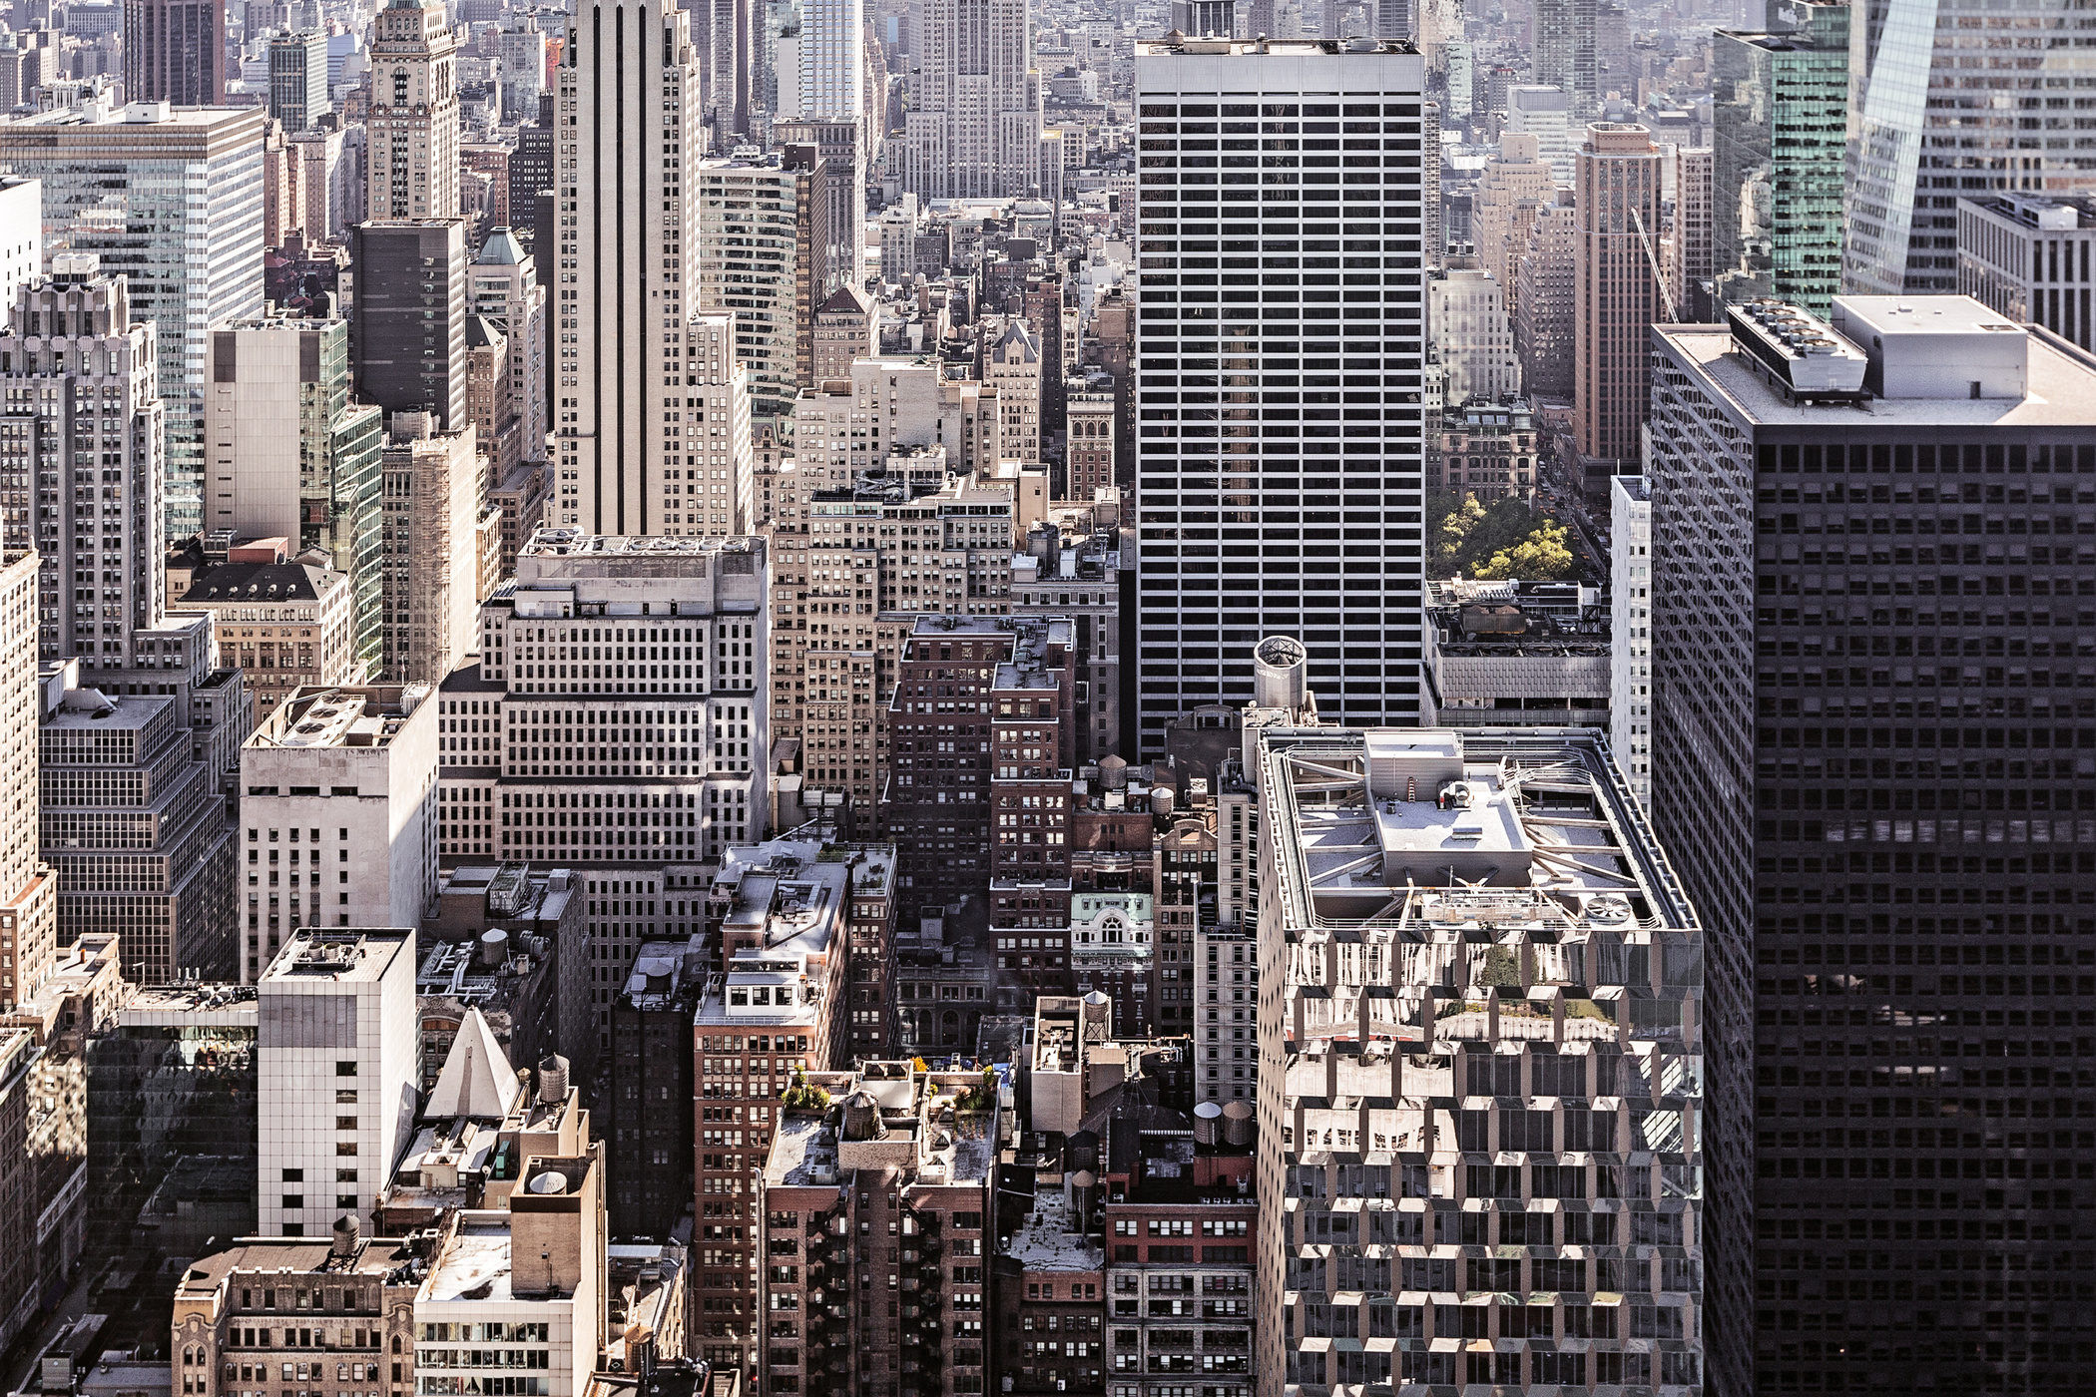


Introduction
Hyperspectral Imaging is a new analytical technique based on spectroscopy. It collects hundreds of images at different wavelengths for the same spatial area. While the human eye has only three color receptors in the blue, green and red, hyperspectral imaging measures the continuous spectrum of the light for each pixel of the scene with fine wavelength resolution, not only in the visible but also in the near-infrared. The collected data form a so-called hyperspectral cube, in which two dimensions represent the spatial extent of the scene and the third its spectral content.

Slide 3



Introduction
Hyperspectral imaging is a powerful technique that goes beyond the limitations of our regular vision to capture and analyze light across a vast spectrum, revealing hidden details invisible to the naked eye. Imagine it as a supercharged camera that sees not just colors, but a rainbow of information at each pixel, like a detailed fingerprint of the object it's looking at.

Slide 4

Previous Work
Various traditional classifier also been used for the classification of objects on the basis of spectral information, such as:
KNN
SVM
Maximum Likelihood
Logistic Regression
Logistic Regression

Slide 5

Problem
Traditional classifier only deal with spectral information of object but fails to preserve the important spatial variability of Hyperspectral data. There should be a way to classify the objects on the basis of both spectral and spatial information
Project Initiation

Slide 6
Solution
Proposed 3D convolutional neural network function over multiple contiguous bands to preserve the joint spatial and spectral information for the feature learning process which exploits important discrimination information for HSIC
Project Initiation

Slide 7
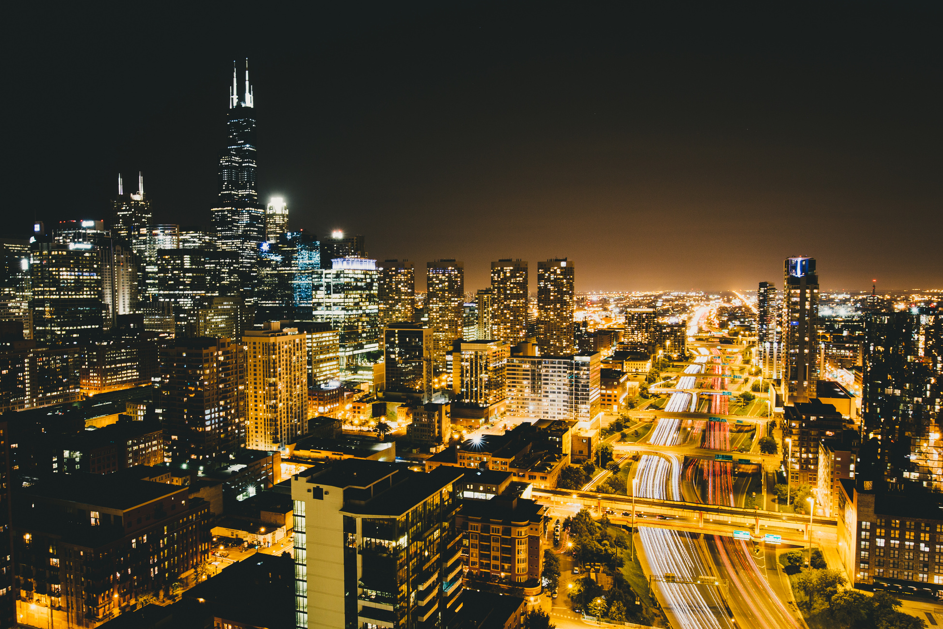
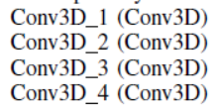
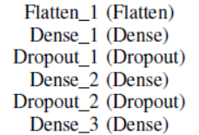
Proposed 3D CNN model
1 Input Layer
Shape Layer: 11, 11, 20, 1
4 3D Convolutional Layer
Output Shape:
First: 9, 9, 14, 8 Second: 7, 7, 10, 16
Third: 5, 5, 8, 32 Fourth: 3, 3, 6, 64
1 Flatten and 2 Dropout Layers with 3 dense layers respectively

Slide 8

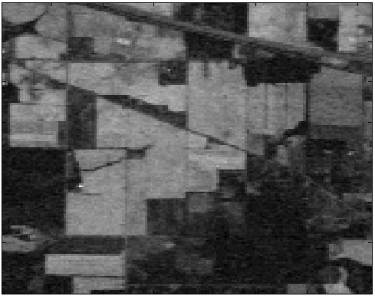
Dataset
Indian Pines is a Hyperspectral image segmentation dataset. The input data consists of hyperspectral bands over a single landscape in Indiana, US, (Indian Pines data set) with 145×145 pixels. For each pixel, the data set contains 220 spectral reflectance bands which represent different portions of the electromagnetic spectrum in the wavelength range 0.4−2.5⋅10−6.

Slide 9
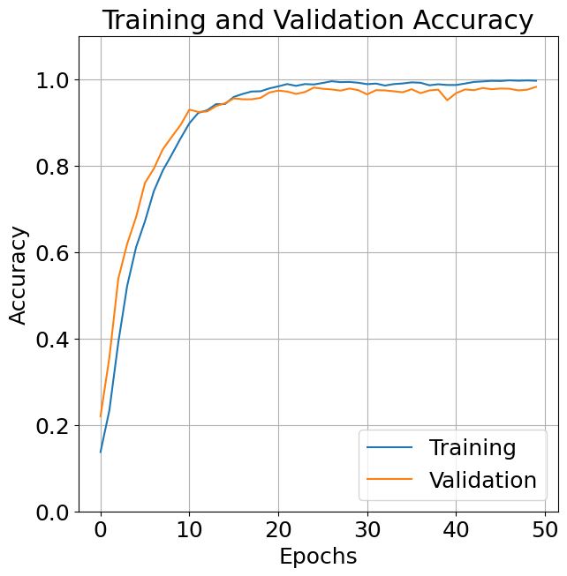
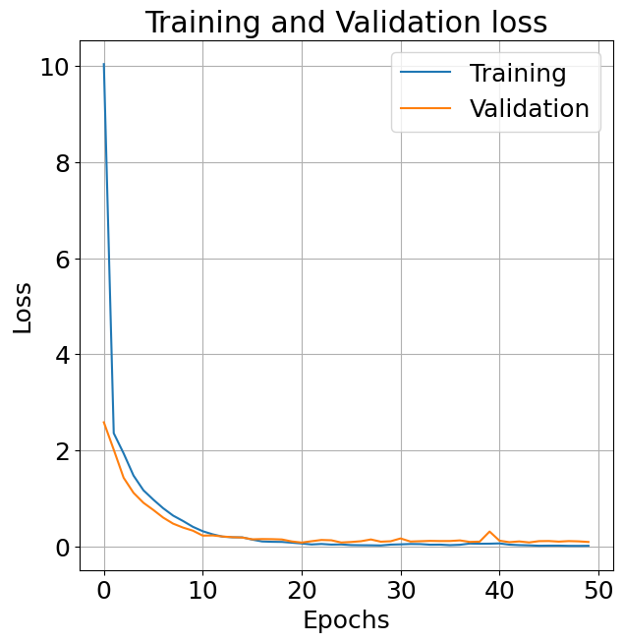

Accuracy and Loss
Accuracy
Loss

Slide 10
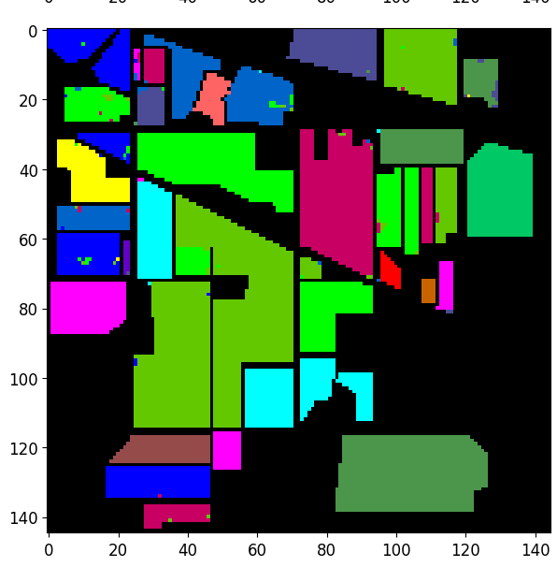
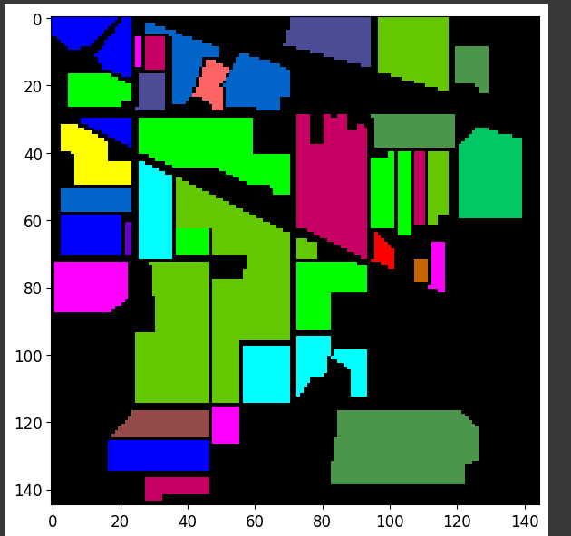
Actual And Predicted Image
Actual
Predicted

Slide 11
Thank You

